Slide 1
Load Balancing, Networking in K8S
Author: Michael Pham

Slide 2
Content
1, Load balancing
2, Service in K8S
3, Ingress
4, Demo K8S in GCP using microk8s

Slide 3
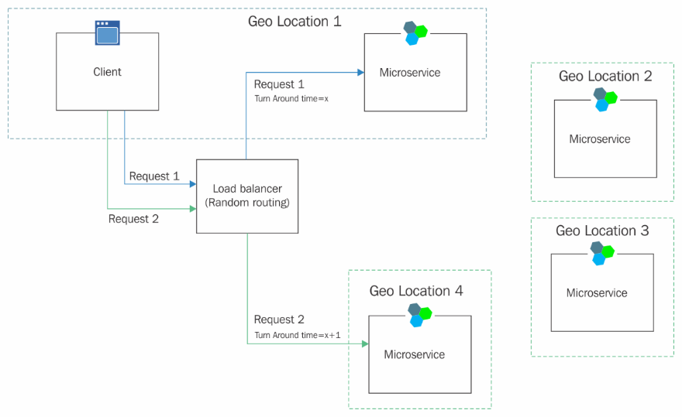
Load balancing
Load balancing refers to efficiently distributing incoming network traffic across a group of backend servers, also known as a server farm or server pool.

Slide 4
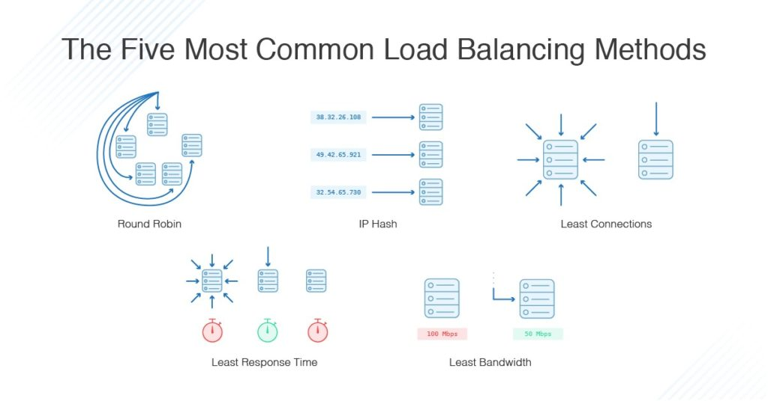
Load Balancing Algorithms
Round Robin
Least Connections
Least Time
Hash
IP Hash

Slide 5
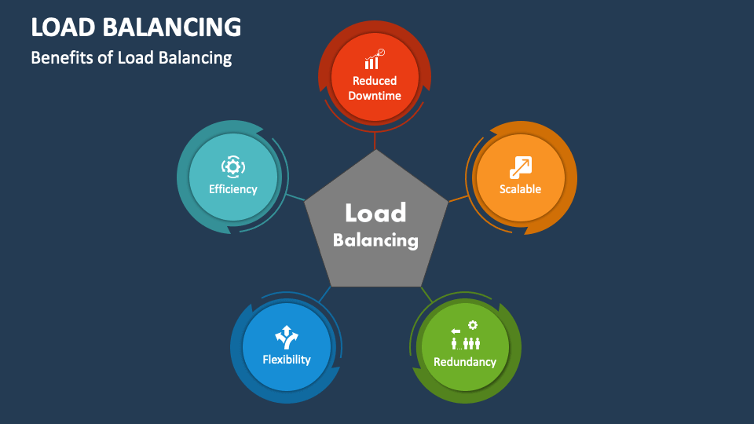
Load balance benefits

Slide 6
Service in k8s
An abstract way to expose an application running on a set of Pods as a network service.
We don’t need service discovery mechanism.
Each time created and destroyed pods by Deployments will created it own IP addresses => Cannot directly connect between two pods. They connect through Service.

Slide 7
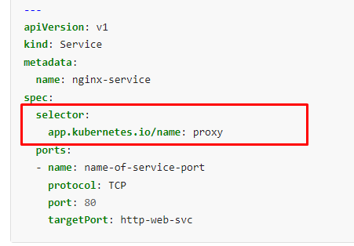
Service with selector
The set of Pods targeted by a Service is usually determined by a selector.

Slide 8
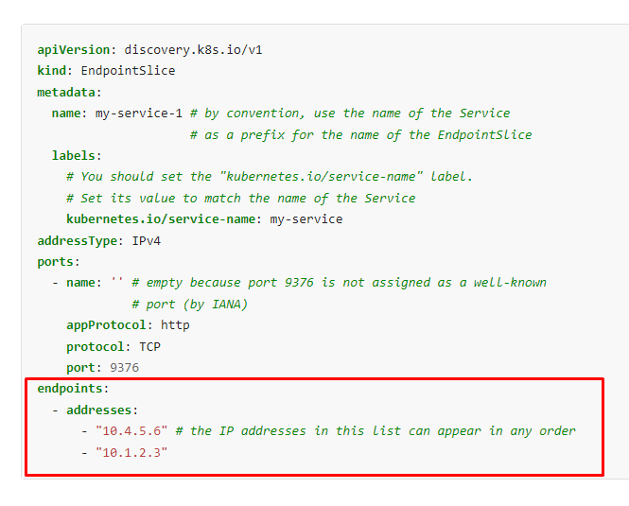
Service without selector
Without selector the Service can abstract other kinds of back-ends, including ones that run outside the cluster.

Slide 9
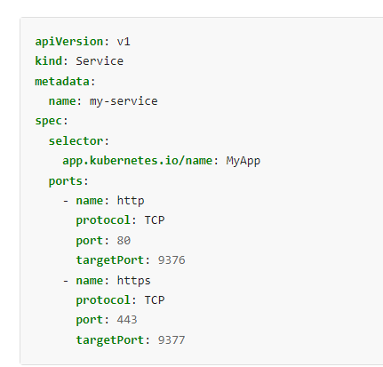
Multi-Port Services
Port exposes the Kubernetes service on the specified port within the cluster
TargetPort is the port on which the service will send requests to, that your pod will be listening on
NodePort exposes a service externally to the cluster by means of the target nodes IP address and the NodePort

Slide 10
Publish Services
ClusterIp: the service to the public with an Ingress or the Gateway API.
Nodeport: static port
Loadbalancer: using a cloud provider's load balancer
ExternalName: returning a CNAME record with its value.

Slide 11
Ingress
What is Ingress?
Ingress Controller
The Ingress resource
Types of Ingress
Load balancing

Slide 12
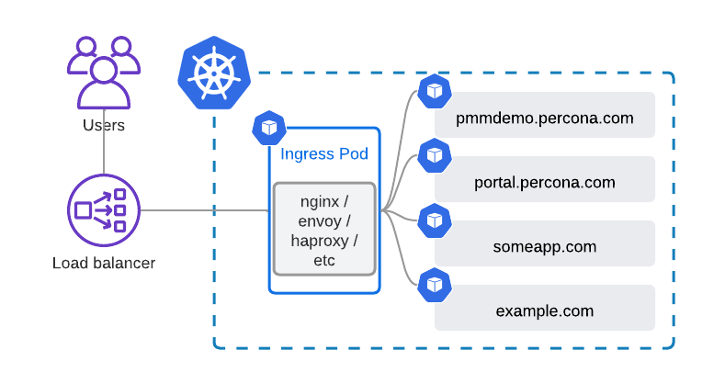
What is Ingress?
Ingress is not a Service type, but it acts as the entry point for your cluster. It lets you consolidate your routing rules into a single resource as it can expose multiple services under the same IP address.

Slide 13
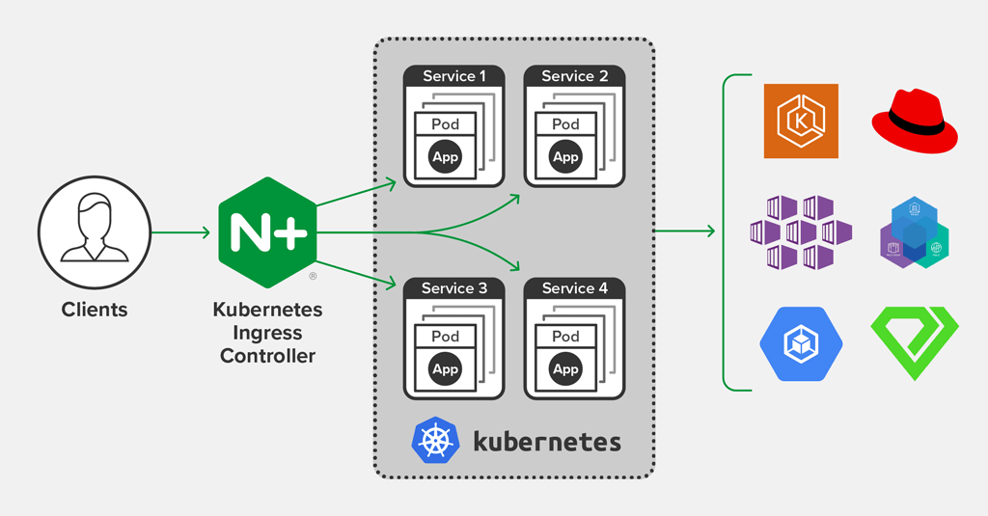
Ingress Controller
An Ingress controller is a specialized load balancer for Kubernetes (and other containerized) environments. Kubernetes is the de facto standard for managing containerized applications

Slide 14
Ingress Controller
Ingress controllers are not started automatically with a cluster
Kubernetes as a project supports and maintains AWS, GCE, and Nginx ingress controllers.
When using microk8s using command: sudo mirok8s enable ingress

Slide 15
The Ingress resource
Ingress rules
DefaultBackend
Path types
Hostname wildcards
Ingress class
Default IngressClass

Slide 16
Types of Ingress
Ingress backed by a single Service
Simple fanout
Name based virtual hosting

Slide 17
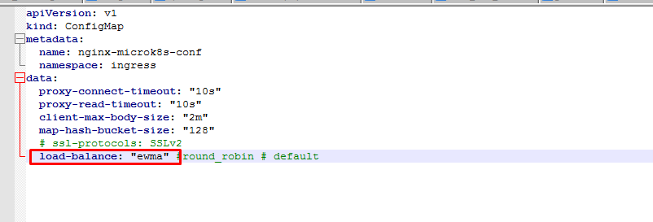
Load balancing
An Ingress controller is bootstrapped with some load balancing policy settings that it applies to all Ingress, such as the load balancing algorithm, backend weight scheme, and others

Slide 18
References
https://www.nginx.com/resources/glossary/load-balancing/
https://www.ibm.com/topics/load-balancing#:~:text=Load%20balancing%20lets%20you%20evenly,user%20requests%20quickly%20and%20accurately.
https://kubernetes.io/docs/concepts/services-networking/service/
https://kubernetes.io/docs/concepts/services-networking/ingress/
https://www.bmc.com/blogs/kubernetes-port-targetport-nodeport/
kubernetes - What is a difference between Ingress and Ingress controller? - Stack Overflow
Ingress Controllers | Kubernetes

Slide 19

End.

